Slide 1
Chapter 6: Entity-Relationship Model

Slide 2
Contents
Modeling
Constraints
E-R Diagram
Design Issues
Weak Entity Sets
Extended E-R Features
Design of the Bank Database
Reduction to Relation Schemas
Database Design
Chapter5 Entity-Relationship Model

Slide 3
Modeling
A database can be modeled as:
  a collection of entities,
  relationships among entities.
Chapter5 Entity-Relationship Model
Notes:
数据库可以建模为：
实体集合，
实体之间的关系。

Slide 4
Entity Set
An entity is an object that exists and is distinguishable from other objects.
An entity set is a set of entities of the same type that share the same properties.
specific person, company, event, plant
set of all persons, companies, trees, holidays
Chapter5 Entity-Relationship Model
Notes:
实体是存在的对象，可以与其他对象区分开来。
实体集是一组具有相同类型、共享相同属性的实体。

Slide 5
Attributes
An entity is represented by a set of attributes, that is descriptive properties possessed by all members of an entity set.
customer = (customer_id, customer_name, customer_street, customer_city )
loan = (loan_number, amount )
Chapter5 Entity-Relationship Model
Notes:
一个实体由一组属性表示，这是一个实体集的所有成员所拥有的描述性属性。

Slide 6
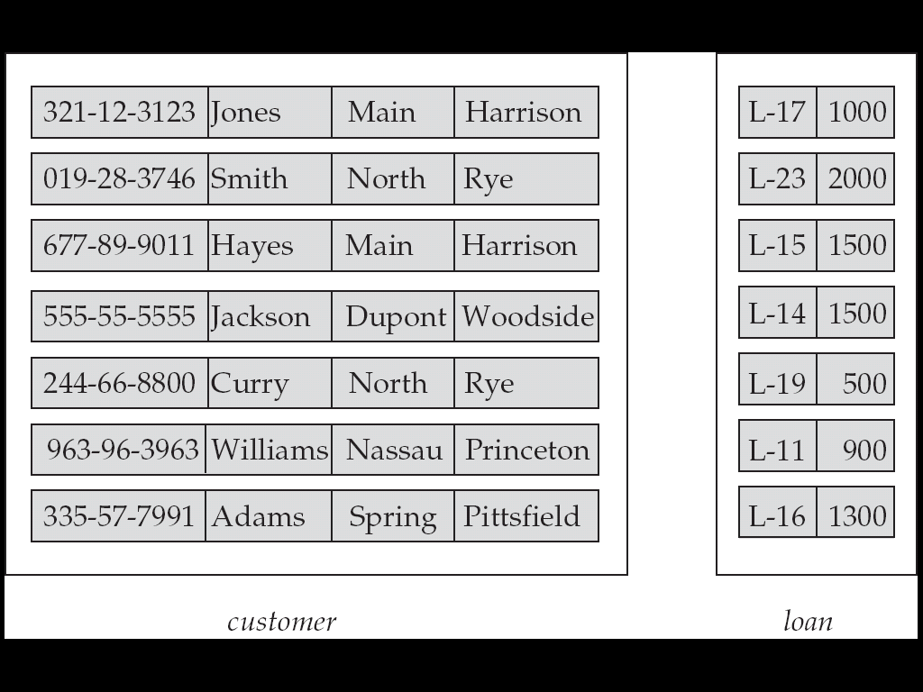
Entity Sets customer and loan
customer_id
customer_name
customer_street
customer_city
Loan _number
amount
Customer
Loan
Chapter5 Entity-Relationship Model

Slide 7
Attributes
Cont.
Each entity has a value for each of its attributes
An attribute has a null value when an attribute dos not have value for it
Domain – the set of permitted values for each attribute
Attribute types:
  Simple and composite attributes.
  Single-valued and multi-valued attributes
  Derived attributes
Chapter5 Entity-Relationship Model
Notes:
每个实体的每个属性都有一个值
当属性没有空值时，该属性具有空值
域–每个属性的允许值集
属性类型：
简单和复合属性。
单值和多值属性
派生属性

Slide 8
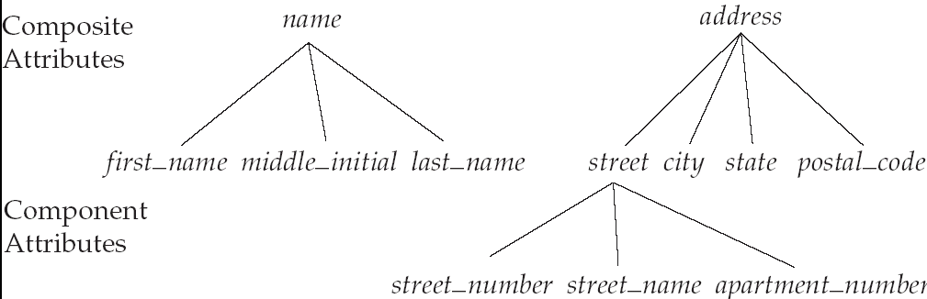
Simple and Composite Attributes
Simple attributes: can not be divided into subparts
Composite attributes: can be divided into subparts
Chapter5 Entity-Relationship Model
Notes:
简单属性：不能分为子部分
复合属性：可分为子部分

Slide 9
Composite Attributes
Good choice if we refer to an entire attribute on some occasions, and to only a component of the attribute on other occasions
Help to group together related attributes, making the modeling cleaner
Chapter5 Entity-Relationship Model
Notes:
如果我们在某些情况下引用整个属性，而在其他情况下只引用属性的一个组件，则是很好的选择。
帮助将相关属性分组，使建模更清晰

Slide 10
Single-Valued and Multi-Valued Attributes
Single-valued attributes: have a single value for an particular entity
Multi-valued attributes: have multiple values for an particular entity
An account can have only one account number ➔ the account_number attribute for an specific account entity is single valued
A customer may have multiple phones ➔ the phone_number attribute for a specific customer entity is multiple valued
Chapter5 Entity-Relationship Model
Notes:
单值属性：具有特定实体的单值
多值属性：具有特定实体的多个值

Slide 11
Derived Attributes
The value of derived attribute can be derived from the values of other related attributes or entities
If the customer entity set has an attribute loan_held, which represent how many loans a customer has from the bank.
We can derive the value of this attribute by counting the number of loan entities associated with that customer
Chapter5 Entity-Relationship Model
Notes:
派生属性的值可以从其他相关属性或实体的值派生

Slide 12
Relationship Sets**
A relationship is an association among several entities
Example
Hayes is a customer with A-102
customer entity relationship account entity
Chapter5 Entity-Relationship Model
Notes:
关系是多个实体之间的关联。

Slide 13
Relationship Sets
Cont.
A relationship set is a set of relationships of the same type,
if E1, E2, ..., En are entity sets, a relationship set R is a subset of
{(e₁, e₂, … e_{n}) | e₁ ∈ E₁, e₂ ∈ E₂, …, e_{n} ∈ E_{n}}
where (e₁, e₂, …, e_{n}) is a relationship
Chapter5 Entity-Relationship Model
Notes:
关系集是一组相同类型的关系，
如果e1，e2，…，en是实体集，那么关系集r是

Slide 14
Relationship Set borrower
Customer
Loan
Chapter5 Entity-Relationship Model

Slide 15
Relationship Sets
Cont.
An attribute can also be property of a relationship set
Example
the depositor relationship set between entity sets customer and account may have the attribute access-date
Chapter5 Entity-Relationship Model
Notes:
属性也可以是关系集的属性
实体集客户和账户之间的储户关系集可以具有属性访问日期。

Slide 16

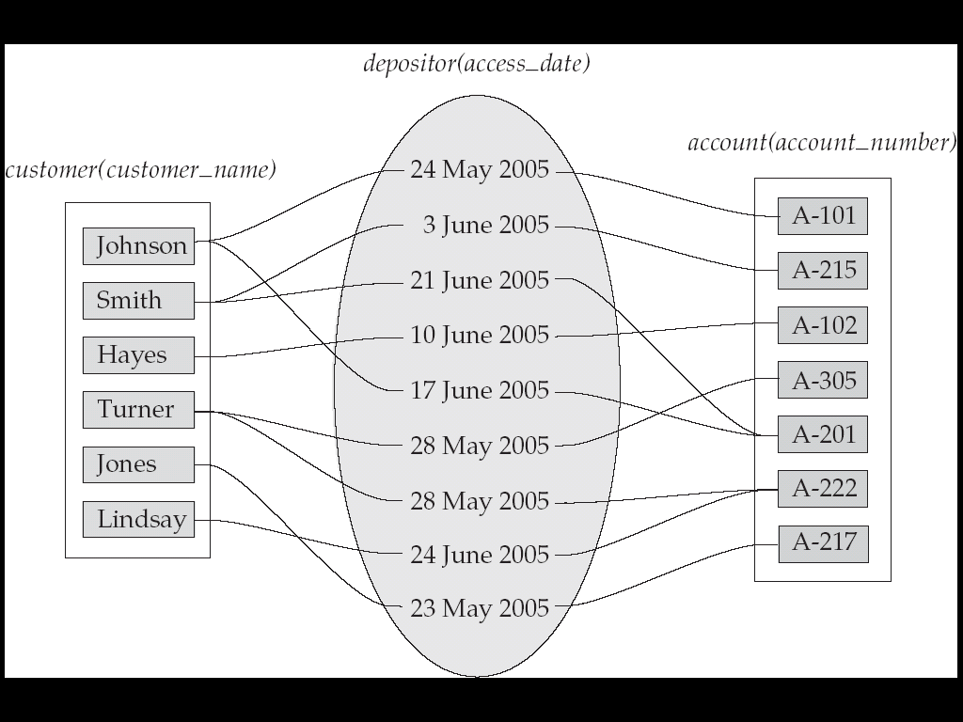
Example
Chapter5 Entity-Relationship Model

Slide 17
Degree of a Relationship Set__
Refers to number of entity sets that participate in a relationship set.
Relationship sets that involve two entity sets are binary (or degree two).
Generally, most relationship sets in a database system are binary.
Chapter5 Entity-Relationship Model

Slide 18
Degree of a Relationship Set
Cont.
Relationship sets may involve more than two entity sets.
Relationships between more than two entity sets are rare. Most relationships are binary. (More on this later.)
Suppose employees of a bank may have jobs at multiple branches, with different jobs at different branches. Then there is a ternary relationship set between entity sets employee, job, and branch
Chapter5 Entity-Relationship Model

Slide 19
Mapping Cardinality Constraints
Express the number of entities to which another entity can be associated via a relationship set.
Chapter5 Entity-Relationship Model

Slide 20
Mapping Cardinality Constraints
Cont.
Most useful in describing binary relationship set
For a binary relationship set the mapping cardinality must be one of the following types:
  One to one
  One to many
  Many to one
  Many to many
Chapter5 Entity-Relationship Model

Slide 21
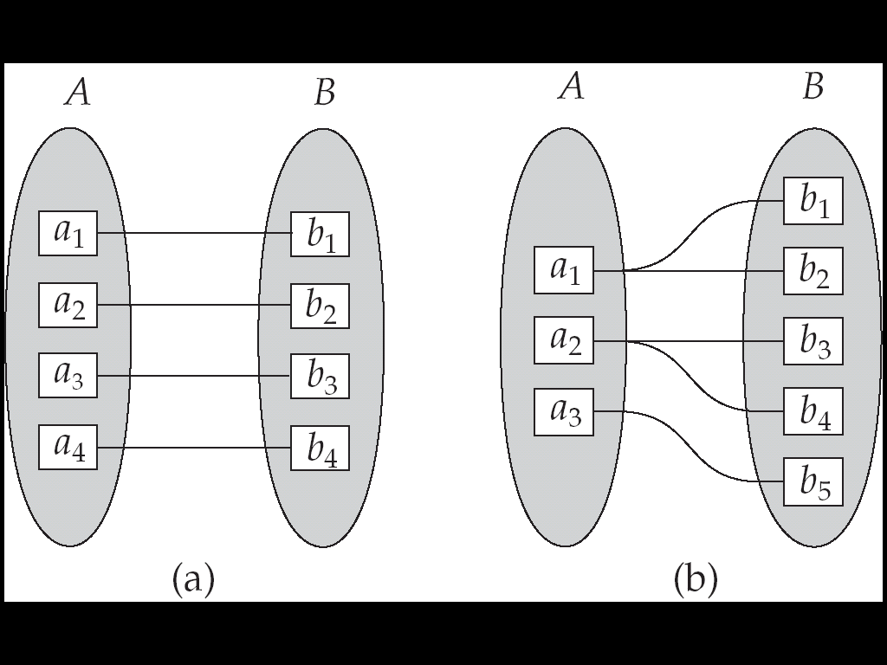
Mapping Cardinalities
One to one
One to many
Note: Some elements in A and B may not be mapped to any elements in the other set
Chapter5 Entity-Relationship Model

Slide 22
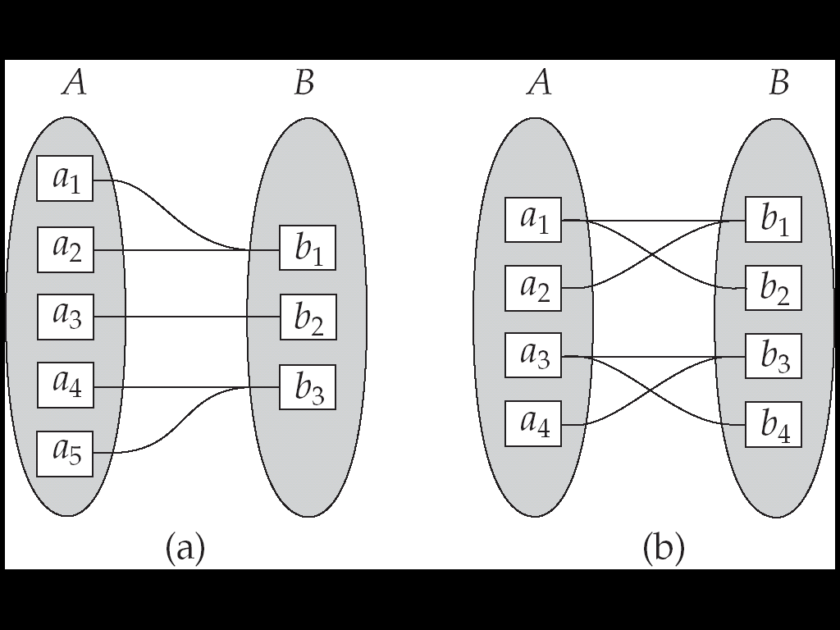
Mapping Cardinalities
Many to one
Many to many
Note: Some elements in A and B may not be mapped to any elements in the other set
Chapter5 Entity-Relationship Model

Slide 23
Participation Constraints
E is entity set and R is relationship set
If every entity in E participates in at least one relationship in R ➔ the participation of E in R is total
If only some entities in E participate in relationships in R ➔ the participation of E in R is partial
Chapter5 Entity-Relationship Model

Slide 24

Example
Total Participation
Partial Participation
Customer
Account
Chapter5 Entity-Relationship Model

Slide 25
Keys
A super key of an entity set is a set of one or more attributes whose values uniquely determine each entity.
A candidate key of an entity set is a minimal super key
{customer_id} is a super key of customer
{customer_id, customer_street} is super key of customer
Candidate Key
Chapter5 Entity-Relationship Model

Slide 26
Keys
Cont.
Although several candidate keys may exist, one of the candidate keys is selected to be the primary key.
  Primary key should be chosen such that its attributes never, or very rarely changed
Chapter5 Entity-Relationship Model

Slide 27
Keys for Relationship Sets
Let R is a relationship set involving entity set E₁, E₂,…E_{n}, an relationship in relationship set R is described by:
Primary-key(E₁) ∪ Primary-key(E₂) ∪
... ∪Primary-key(E_{n})∪{a₁,a₂,…,a_{m}}
Superkey
Primary-key(Ei) denote the set of attributes that forms the primary key of entity set E
{a₁,a₂,…a_{n}} is Attributes of relationship set R
Chapter5 Entity-Relationship Model

Slide 28
Keys for Relationship Sets
Cont.
The combination of primary keys of the participating entity sets forms a super key of a relationship set
(customer_name, account_number) is the super key of depositor
NOTE: this means a pair of entity can have at most one relationship in a particular relationship set
Chapter5 Entity-Relationship Model

Slide 29
Keys for Relationship Sets
Cont.
Must consider the mapping cardinality of the relationship set when deciding what are the candidate keys
P(A) or P(B)
P(B)
P(A)
P(A) U P(B)
Chapter5 Entity-Relationship Model

Slide 30
Keys for Relationship Sets
Cont.
Need to consider semantics of relationship set in selecting the primary key in case of more than one candidate key
Account
Depositor
Customer
P(A) or P(B)
Chapter5 Entity-Relationship Model

Slide 31
E-R Diagrams
Rectangles represent entity sets.
Diamonds represent relationship sets.
Lines link attributes to entity sets and entity sets to relationship sets.
Ellipses represent attributes
  Double ellipses represent multivalued attributes.
  Dashed ellipses denote derived attributes.
Underline indicates primary key attributes
Chapter5 Entity-Relationship Model

Slide 32
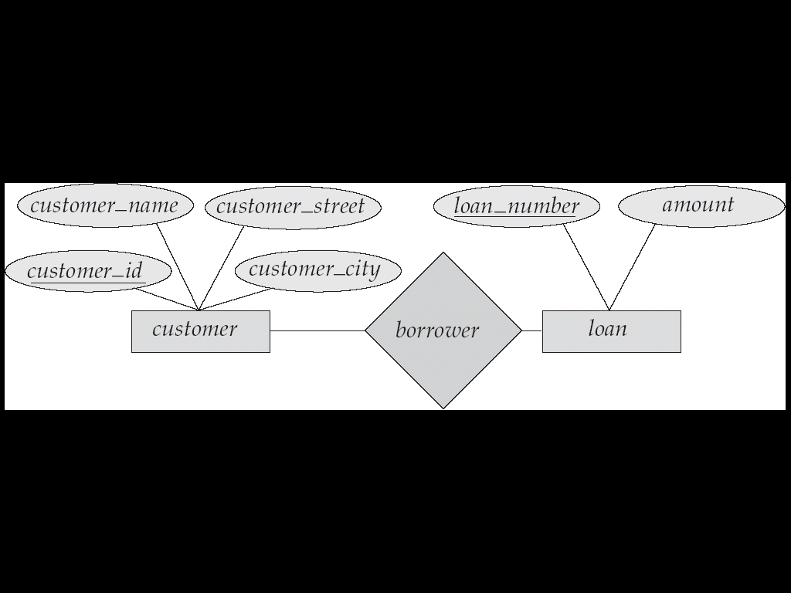
E-R Diagrams
Cont.
Chapter5 Entity-Relationship Model

Slide 33
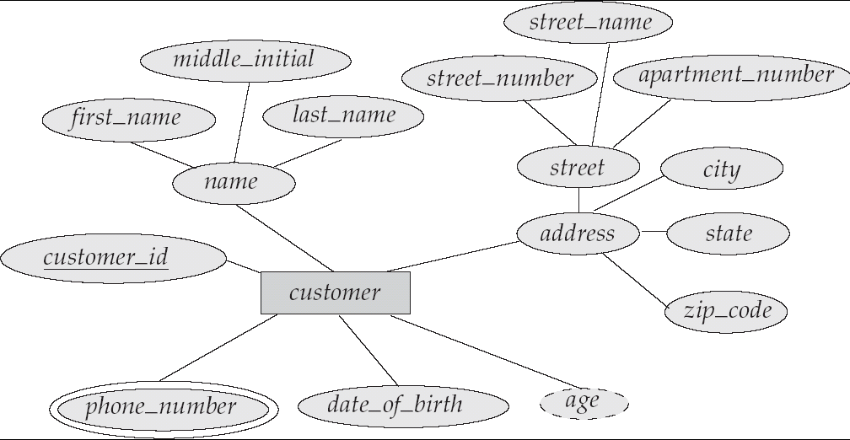
E-R Diagram With Composite, Multivalued, and Derived Attributes
composite
composite
multi-value
derived
Chapter5 Entity-Relationship Model

Slide 34
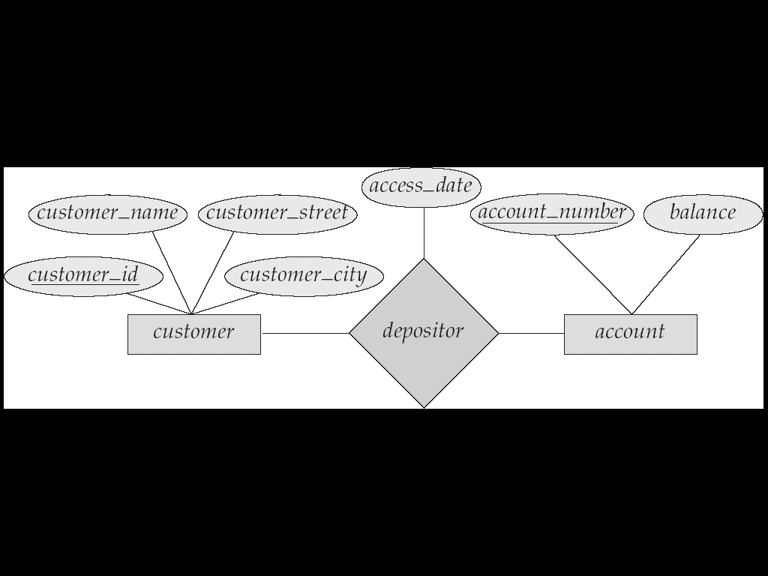
Relationship Sets with Attributes
Chapter5 Entity-Relationship Model

Slide 35
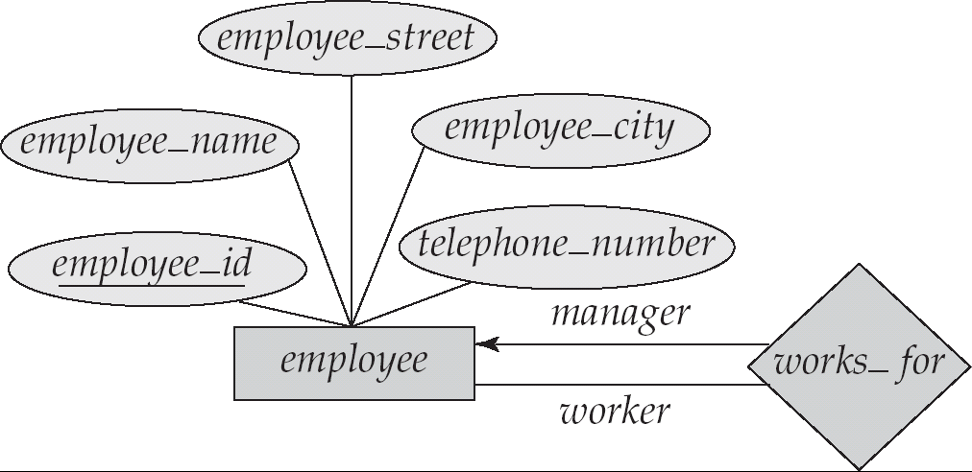
Roles
Entity sets involved in a relationship set need not to be distinct
Can use roles to specify how entities interact via relationship set
optional
roles
Chapter5 Entity-Relationship Model

Slide 36
Cardinality Constraints
We express cardinality constraints by drawing either
  a directed line (→), signifying “one,”
  an undirected line (—), signifying “many,”
between the relationship set and the entity set.
Chapter5 Entity-Relationship Model

Slide 37
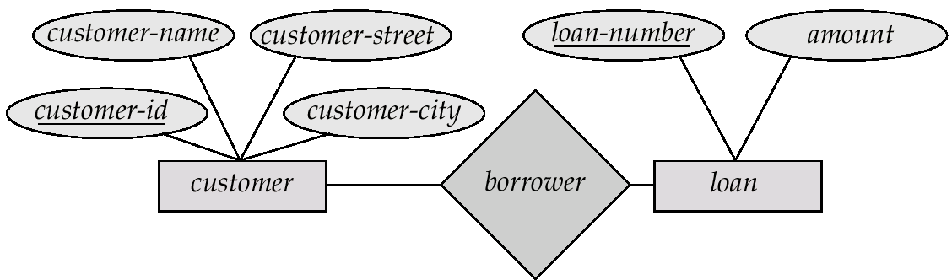
One-to-one relationship
Example
A customer is associated with at most one loan via the relationship borrower
A loan is associated with at most one customer via borrower
Chapter5 Entity-Relationship Model

Slide 38
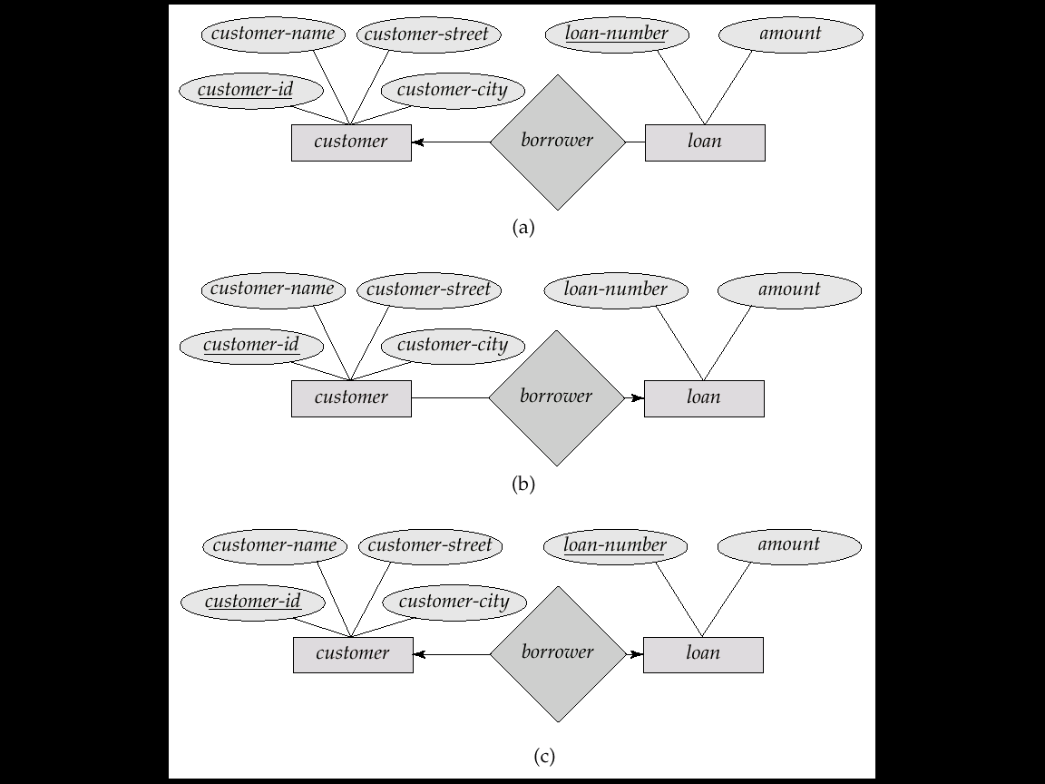
One-To-Many Relationship
Example
a loan is associated with at most one customer via borrower
a customer is associated with several (including 0) loans via borrower
Chapter5 Entity-Relationship Model

Slide 39
Many-To-One Relationships
Example
a loan is associated with several (including 0) customers via borrower
a customer is associated with at most one loan via borrower
Chapter5 Entity-Relationship Model

Slide 40
Many-To-Many Relationship
Example
A customer is associated with several (possibly 0) loans via borrower
A loan is associated with several (possibly 0) customers via borrower
Chapter5 Entity-Relationship Model

Slide 41
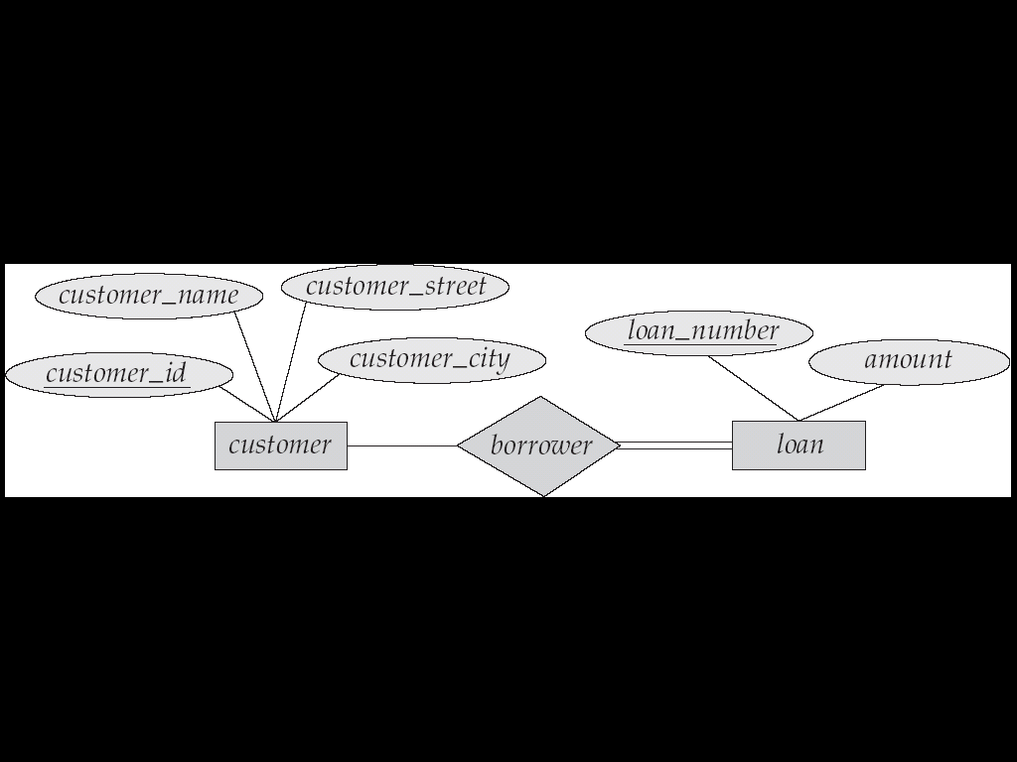
Participation of an Entity Set in a Relationship Set
Total participation is indicated by double line
Every loan must have a customer associated to it via borrower, participation of customer in borrower is partial
Example
Chapter5 Entity-Relationship Model

Slide 42
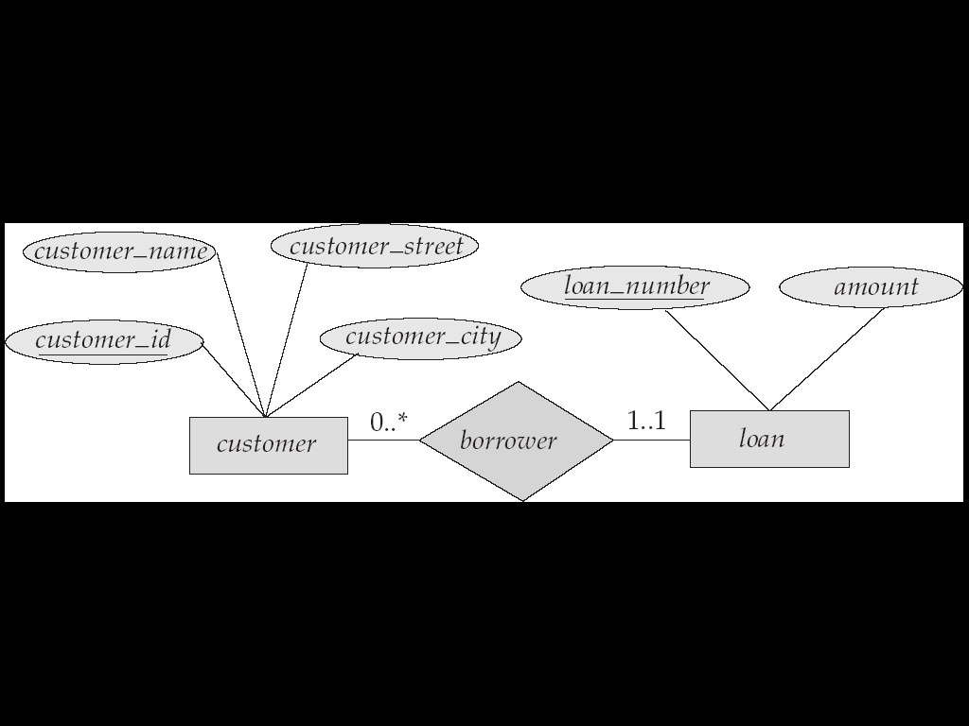
Alternative Notation for Cardinality Limits
Cardinality limits can also express participation constraints
Chapter5 Entity-Relationship Model

Slide 43
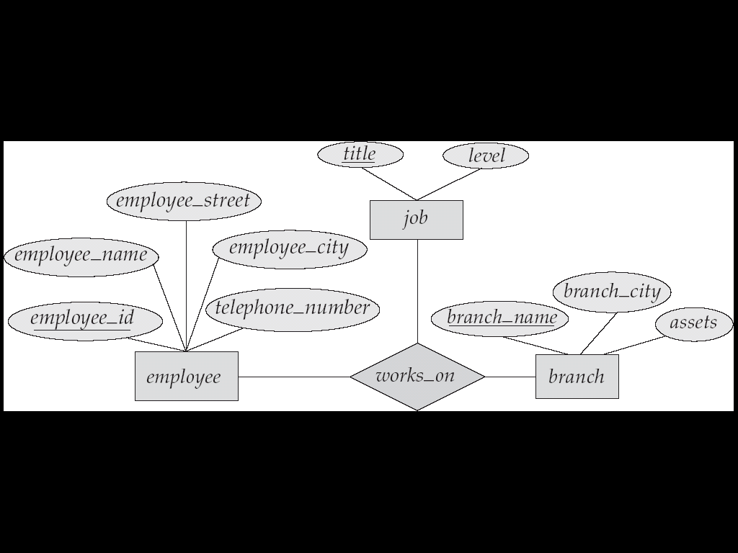
E-R Diagram with a Ternary Relationship
Chapter5 Entity-Relationship Model

Slide 44
Cardinality Constraints on Ternary Relationship
We allow at most one arrow out of a ternary (or greater degree) relationship to indicate a cardinality constraint
If there is more than one arrow, there are two ways of defining the meaning
An arrow from works_on to job indicates each employee works on at most one job at any branch
Chapter5 Entity-Relationship Model

Slide 45
A ternary relationship R between A, B and C with arrows to B and C could mean
A
R
B
C
  1. each A entity is associated with a unique entity from B and C or
  2. each pair of entities from (A, B) is associated with a unique C entity, and each pair (A, C) is associated with a unique B
To avoid confusion we outlaw more than one arrow
Chapter5 Entity-Relationship Model

Slide 46
Design Issues
Use of entity sets vs. attributes
Choice mainly depends on the structure of the enterprise being modeled, and on the semantics associated with the attribute in question
Chapter5 Entity-Relationship Model

Slide 47
Example
Want to keep extra information about telephone
name
Telephonenumber
employee
Telephonenumber
location
type
name
Telephonenumber
employee
telephone
Do not use the primary key of an entity set as an attribute of another entity set
Chapter5 Entity-Relationship Model

Slide 48
Make connections between entity sets explicitly
location
type
name
Telephonenumber
employee
emp_phone
telephone
Do not designate the primary key attributes of the related entity sets as attributes of the relationship set (already implicit in)
Chapter5 Entity-Relationship Model

Slide 49
Design Issues
Cont.
Use of entity sets vs. relationship sets
Possible guideline is to designate a relationship set to describe an action that occurs between entities
Chapter5 Entity-Relationship Model

Slide 50
Example
Loan number
amount
customer
borrower
loan
Alternative way
Loan number
amount
customer
loan
branch
Can cause replication
When several customers can hold a loan jointly, must define a separate relationship for each holder of the loan, each such relationship has same value for loan_number and amount
Chapter5 Entity-Relationship Model

Slide 51
Design Issues
Cont.
Binary versus n-ary relationship sets
Although it is possible to replace any nonbinary (n-ary, for n > 2) relationship set by a number of distinct binary relationship sets, a n-ary relationship set shows more clearly that several entities participate in a single relationship.
Chapter5 Entity-Relationship Model

Slide 52
Binary Vs. Non-Binary Relationships
Some relationships that appear to be non-binary may be better represented using binary relationships
  A ternary relationship parents, relating a child to his/her father and mother, is best replaced by two binary relationships, father and mother
    Using two binary relationships allows partial information (e.g. only mother being know)
Chapter5 Entity-Relationship Model

Slide 53
Example
parents
father
child
mother
person
better represented by
mother
father
mother
person
father
child
child
Allows partial inforamtion
Chapter5 Entity-Relationship Model

Slide 54
Example
branch
job
works_on
employee
Can not transformed directly to
branch
job
employee
works_on
works_on
Chapter5 Entity-Relationship Model

Slide 55
Converting Non-Binary Relationships to Binary Form
In general, any non-binary relationship can be represented using binary relationships by creating an artificial entity set
  Replace R between entity sets A, B and C by an entity set E, and three relationship sets:
    R_{A}, relating E and A
    R_{B}, relating E and B
    R_{C}, relating E and C
Chapter5 Entity-Relationship Model

Slide 56
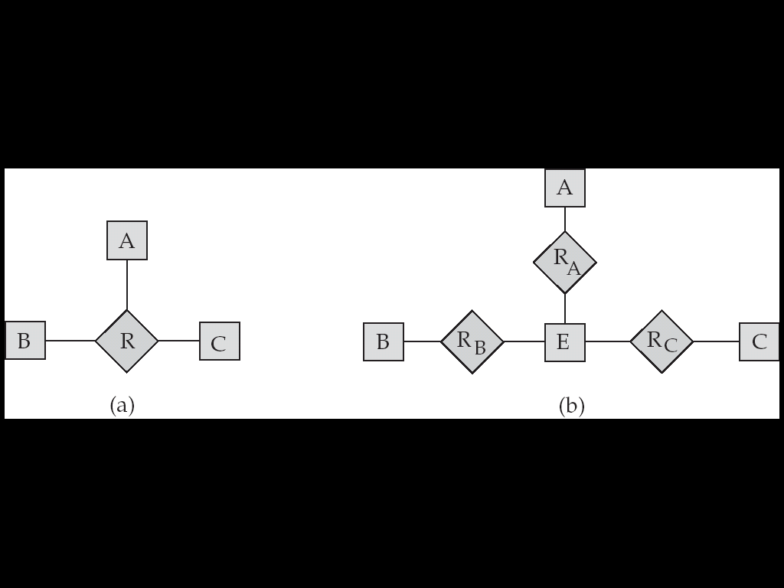
  Create a special identifying attribute for E
  Add any attributes of R to E
  For each relationship (a_{i} , b_{i} , c_{i}) in R, create
    a new entity e_{i} in the entity set E
    add (e_{i} , a_{i} ) to R_{A}
    add (e_{i} , b_{i} ) to R_{B}
    add (e_{i} , c_{i} ) to R_{C}
Chapter5 Entity-Relationship Model

Slide 57
Converting Non-Binary Relationships to Binary Form
Drawbacks of converting
  An identifying attribute may have to be created for the entity set representing the relationship set
  A n-ray relationship set shows more clearly that several entities participate in a single relationship
  There may not be alway to translate constraints on the ternary relationship to constraints on the binary relationships
Chapter5 Entity-Relationship Model

Slide 58
Example
Each pair of entities from A and B is associated with at most one C entity
?
Can not be represented
Chapter5 Entity-Relationship Model

Slide 59
Design Issues
Cont.
Placement of relationship attributes
  Can make access-date an attribute of account, instead of a relationship attribute, if each account can have only one customer
  That is, the relationship from account to customer is many to one, or equivalently, customer to account is one to many
Chapter5 Entity-Relationship Model

Slide 60
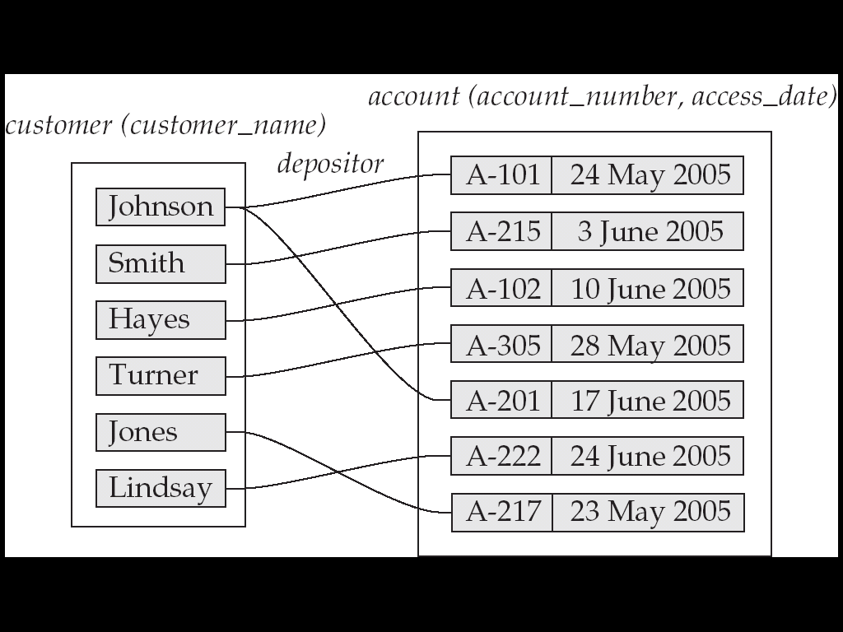
Example
Attributes of one-to-many relationship set can be repositioned to only the entity set on the “many” side.
for one-to-one relationship set, On the other hand, can be placed on either sides.
Chapter5 Entity-Relationship Model

Slide 61
Example
For many-to-may relationship, attributes of relationship set can only be placed on relationship set
Chapter5 Entity-Relationship Model

Slide 62
Weak Entity Sets***
An entity set that does not have a primary key is referred to as a weak entity set.
The existence of a weak entity set depends on the existence of a identifying entity set
  it must relate to the identifying entity set via a total, one-to-many relationship set from the identifying to the weak entity set
  Identifying relationship depicted using a double diamond
Chapter5 Entity-Relationship Model

Slide 63
Weak Entity Sets
Cont.
The discriminator (or partial key) of a weak entity set is the set of attributes that distinguishes among all the entities of a weak entity set that related to the same entity of identifying entity set.
The primary key of a weak entity set is formed by the primary key of the strong entity set on which the weak entity set is existence dependent, plus the weak entity set’s discriminator.
Chapter5 Entity-Relationship Model

Slide 64
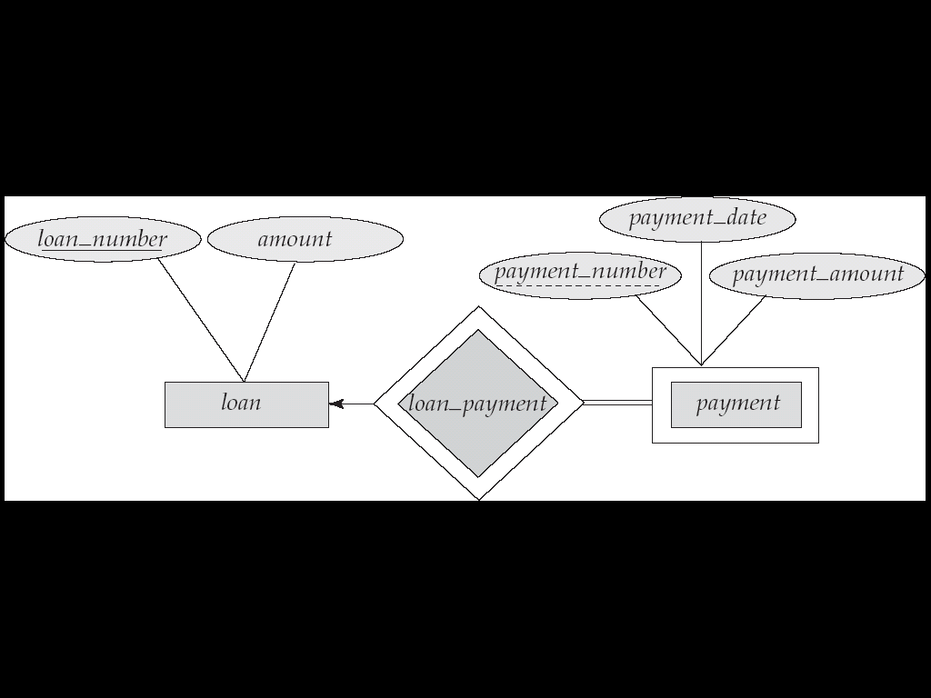
We depict a weak entity set by double rectangles.
We underline the discriminator of a weak entity set with a dashed line.
payment_number – discriminator of the payment entity set
Primary key for payment – (loan_number, payment_number)
Chapter5 Entity-Relationship Model

Slide 65
Extended E-R Features: Specialization
Top-down design process; we designate subgroupings within an entity set that are distinctive from other entities in the set
These subgroupings become lower-level entity sets that have attributes or participate in relationships that do not apply to the higher-level entity set.
Chapter5 Entity-Relationship Model

Slide 66
Extended E-R Features: Specialization
Cont.
Depicted by a triangle component labeled ISA (E.g. customer “is a” person).
Attribute inheritance – a lower-level entity set inherits all the attributes and relationship participation of the higher-level entity set to which it is linked.
Chapter5 Entity-Relationship Model

Slide 67
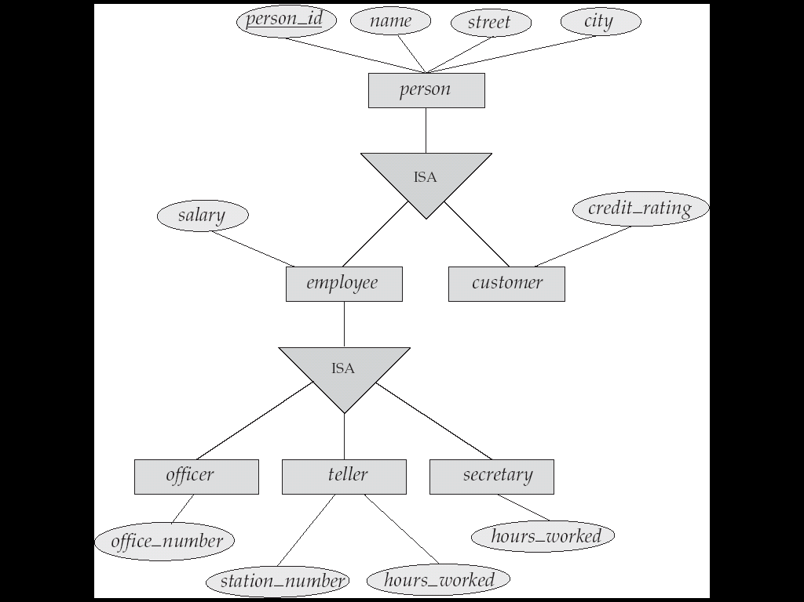
Example
Chapter5 Entity-Relationship Model

Slide 68
Extended ER Features: Generalization
A bottom-up design process – combine a number of entity sets that share the same features into a higher-level entity set.
Specialization and generalization are simple inversions of each other; they are represented in an E-R diagram in the same way.
Chapter5 Entity-Relationship Model

Slide 69
Specialization and Generalization
The terms specialization and generalization are used interchangeably
Can have multiple specializations of an entity set based on different features.
permanent_employee vs. temporary_employee,
in addition to
officer vs. secretary vs. teller
Chapter5 Entity-Relationship Model

Slide 70
Specialization and Generalization
Cont.
Each particular employee would be
  a member of one of permanent_employee or temporary_employee,
  and also a member of one of officer, secretary, or teller
The ISA relationship also referred to as superclass - subclass relationship
Chapter5 Entity-Relationship Model

Slide 71
Design Constraints on a Specialization/Generalization
Constraint on which entities can be members of a given lower-level entity set.
  condition-defined
    Example: all customers over 65 years are members of senior-citizen entity set; senior-citizen ISA person.
  user-defined
Chapter5 Entity-Relationship Model

Slide 72
Design Constraints on a Specialization/Generalization
Cont.
Constraint on whether or not entities may belong to more than one lower-level entity set within a single generalization.
  Disjoint
    an entity can belong to only one lower-level entity set, Noted in E-R diagram by writing disjoint next to the ISA triangle
  Overlapping
    an entity can belong to more than one lower-level entity set
Chapter5 Entity-Relationship Model

Slide 73
Design Constraints on a Specialization/Generalization
Cont.
Completeness constraint -- specifies whether or not an entity in the higher-level entity set must belong to at least one of the lower-level entity sets within a generalization.
  total : an entity must belong to one of the lower-level entity sets
  partial: an entity need not belong to one of the lower-level entity sets
Chapter5 Entity-Relationship Model

Slide 74
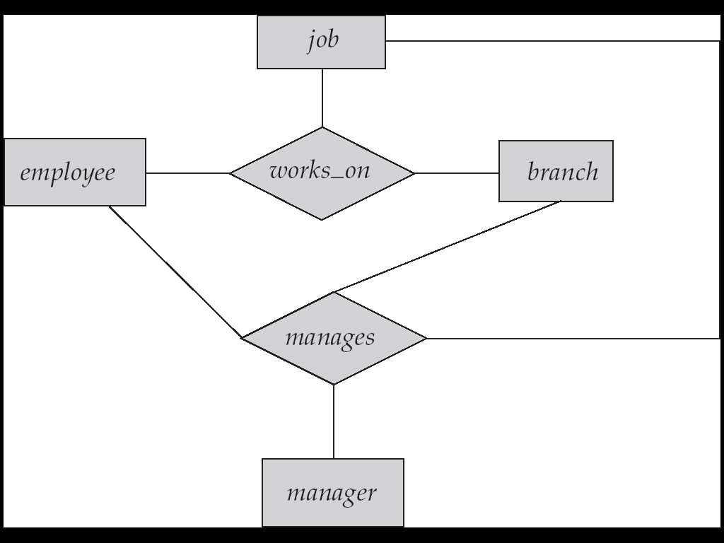
Aggregation
Consider the ternary relationship works_on, which we saw earlier
Suppose we want to record managers for tasks performed by an employee at a branch
Chapter5 Entity-Relationship Model

Slide 75
Aggregation
Cont.
Relationship sets works_on and manages represent overlapping information
  Every manages relationship corresponds to a works_on relationship
  However, some works_on relationships may not correspond to any manages relationships
    So we can’t discard the works_on relationship
Chapter5 Entity-Relationship Model

Slide 76
Aggregation
Cont.
Eliminate this redundancy via aggregation
  Treat relationship as an abstract entity
  Allows relationships between relationships
  Abstraction of relationship into new entity
Without introducing redundancy, the following diagram represents:
  An employee works on a particular job at a particular branch
  An employee, branch, job combination may have an associated manager
Chapter5 Entity-Relationship Model

Slide 77
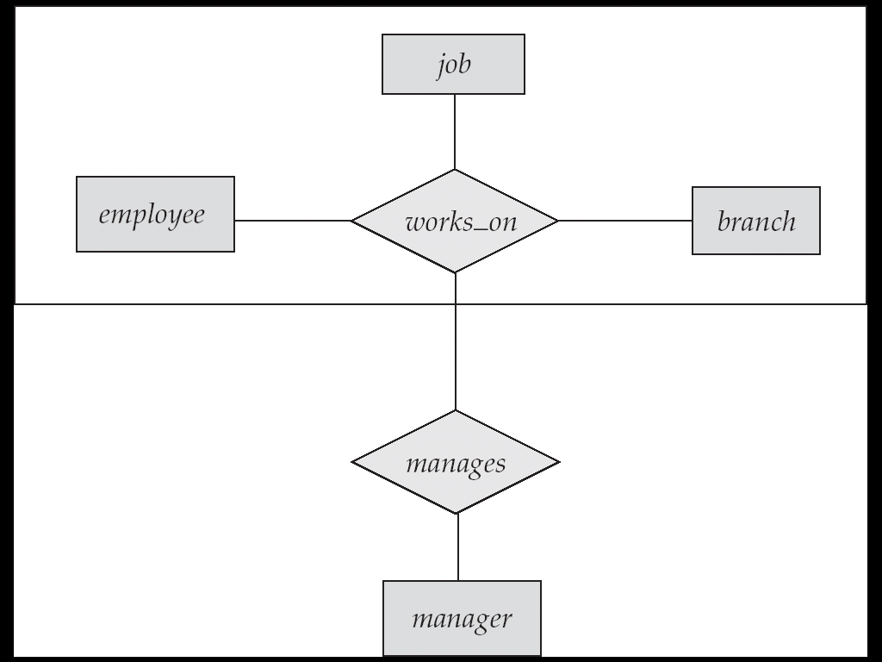
Example
Chapter5 Entity-Relationship Model

Slide 78
E-R Design Decisions
The use of an attribute or entity set to represent an object.
Whether a real-world concept is best expressed by an entity set or a relationship set.
The use of a ternary relationship versus a pair of binary relationships
Chapter5 Entity-Relationship Model

Slide 79
E-R Design Decisions
Cont.
The use of a strong or weak entity set.
The use of specialization/generalization – contributes to modularity in the design.
The use of aggregation – can treat the aggregate entity set as a single unit without concern for the details of its internal structure.
Chapter5 Entity-Relationship Model

Slide 80
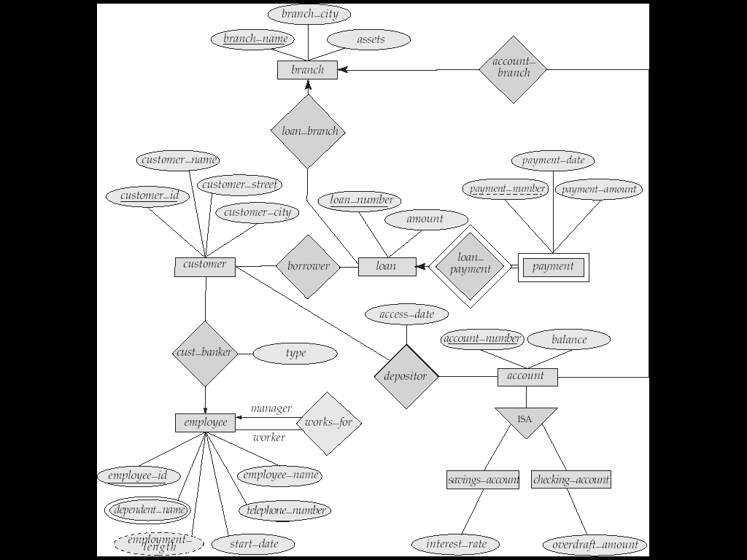
Banking Enterprise
Chapter5 Entity-Relationship Model

Slide 81
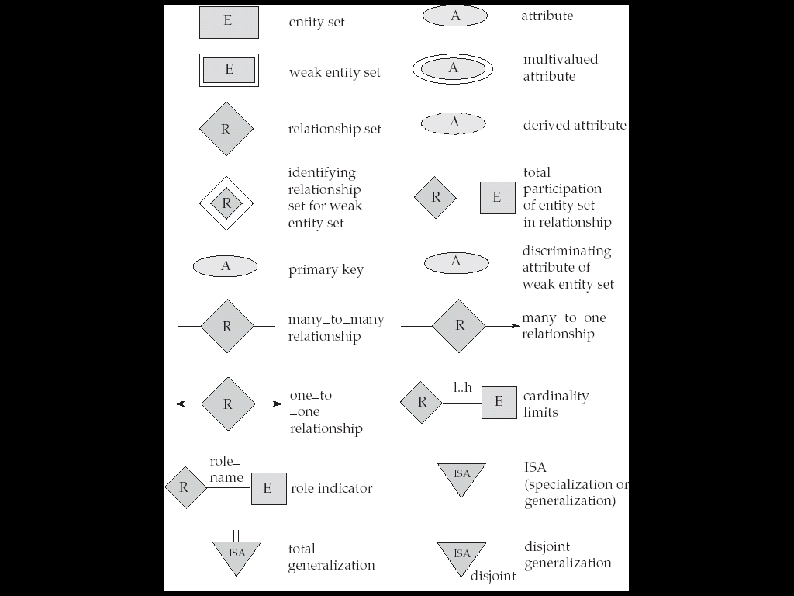
Summary of Symbols in E-R diagram
Chapter5 Entity-Relationship Model

Slide 82
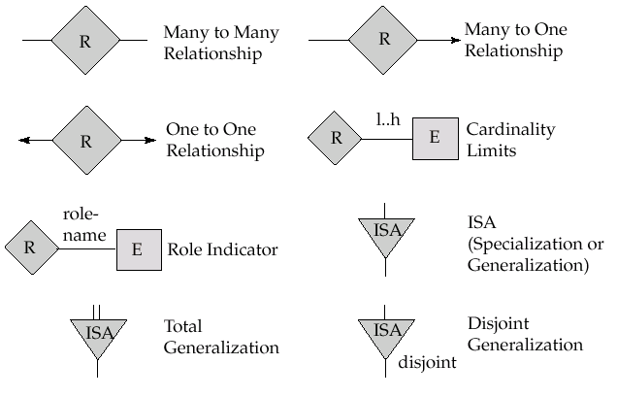
Summary of Symbols in E-R diagram
Chapter5 Entity-Relationship Model

Slide 83
Reduction to Relation Schemas
Primary keys allow entity sets and relationship sets to be expressed uniformly as relation schemas that represent the contents of the database.
A database which conforms to an E-R diagram can be represented by a collection of schemas.
Chapter5 Entity-Relationship Model

Slide 84
Reduction to Relation Schemas
For each entity set and relationship set there is a unique schema that is assigned the name of the corresponding entity set or relationship set.
Each schema has a number of columns (generally corresponding to attributes), which have unique names.
Chapter5 Entity-Relationship Model

Slide 85
Representing Entity Sets as Schemas
A strong entity set reduces to a schema with the same attributes.
A weak entity set becomes a table that includes a column for the primary key of the identifying strong entity set
payment = ( loan_number, payment_number, payment_date, payment_amount )
Chapter5 Entity-Relationship Model

Slide 86
Representing Relationship Sets as Schemas
A many-to-many relationship set is represented as a schema with attributes for the primary keys of the two participating entity sets, and any descriptive attributes of the relationship set.
schema for relationship set borrower
borrower = (customer_id, loan_number )
Chapter5 Entity-Relationship Model

Slide 87
Example
many-to-many relationship set
cname
cstreet
ccity
date
anumber
balance
customer
depositor
account
customer(cname,cstreet,ccity)
Account(anumber,balance)
Depositor(cname, anumber, date)
Chapter5 Entity-Relationship Model

Slide 88
Redundancy of Schemas
Many-to-one and one-to-many relationship sets that are total on the many-side can be represented by adding an extra attribute to the “many” side, containing the primary key of the “one” side
Instead of creating a schema for relationship set account_branch, add an attribute branch_name to the schema arising from entity set account
Chapter5 Entity-Relationship Model

Slide 89
Example
one-to-many relationship set
cname
cstreet
ccity
date
anumber
balance
customer
depositor
account
customer(cname,cstreet,ccity)
Account(anumber,balance)
Depositor(cname, anumber, date)
Account (anumber,balance, cname,date)
Chapter5 Entity-Relationship Model

Slide 90
Redundancy of Schemas
For one-to-one relationship sets, either side can be chosen to act as the “many” side
  That is, extra attribute can be added to either of the tables corresponding to the two entity sets
Chapter5 Entity-Relationship Model

Slide 91
Example
one-to-one relationship set
cname
cstreet
ccity
date
anumber
balance
customer
depositor
account
customer(cname,cstreet,ccity)
Account(anumber,balance)
Depositor(cname, anumber, date)
OR
Account (anumber,balance, cname,date)
OR
customer(cname,cstreet,ccity,anumber,date)
Chapter5 Entity-Relationship Model

Slide 92
Redundancy of Schemas
If participation is partial on the “many” side, replacing a schema by an extra attribute in the schema corresponding to the “many” side could result in null values
The schema corresponding to a relationship set linking a weak entity set to its identifying strong entity set is redundant
Chapter5 Entity-Relationship Model

Slide 93
Example
identifying relationship
pnumber
lnumber
amount
pdate
pamount
loan
loan_payment
payment
loan(lnumber,amount)
payment(pnumber, pdate, pamount,lnumber)
Chapter5 Entity-Relationship Model

Slide 94
Composite Attributes
Composite attributes are flattened out by creating a separate attribute for each component attribute
Example
street
city
cname
Address
customer(cname, street, city)
customer
Chapter5 Entity-Relationship Model

Slide 95
Multivalued Attributes
A multivalued attribute M of an entity E is represented by a separate schema EM
  Schema EM has attributes corresponding to the primary key of E and an attribute corresponding to multivalued attribute M
  Each value of the multivalued attribute maps to a separate tuple of the relation on schema EM
Chapter5 Entity-Relationship Model

Slide 96
Example
street
city
Address
cname
phone
customer
customer(cname, street, city)
phone(cname, phone)
Chapter5 Entity-Relationship Model

Slide 97
Example
name：smith
city： brooklin
street：perridge
phone：20311026 22343369 13350236789
Customer(cname, street, city)
Phone(cname, phone)
cname street city
cname phone
smith
perridge
brooklin
smith
20311026
smith
22343369
smith
1335023689
Chapter5 Entity-Relationship Model

Slide 98
Representing Specialization as Schemas
Method 1:
  Form a schema for the higher-level entity
  Form a schema for each lower-level entity set, include primary key of higher-level entity set and local attributes
  schema attributes
  person name, street, city
  customer name, credit_rating
  employee name, salary
Chapter5 Entity-Relationship Model

Slide 99
Representing Specialization as Schemas
Cont.
Method 1
  Drawback: getting information about, an employee requires accessing two relations, the one corresponding to the low-level schema and the one corresponding to the high-level schema
Cont.
Chapter5 Entity-Relationship Model

Slide 100
Representing Specialization as Schemas
Cont.
Method 2:
  Form a schema for each entity set with all local and inherited attributes
schema attributes
person name, street, city
customer name, street, city, credit_rating
employee name, street, city, salary
Chapter5 Entity-Relationship Model

Slide 101
Representing Specialization as Schemas
Cont.
Cont.
Method 2:
  If specialization is total, the schema for the generalized entity set (person) not required to store information
    Can be defined as a “view” relation containing union of specialization relations
    But explicit schema may still be needed for foreign key constraints
Chapter5 Entity-Relationship Model

Slide 102
Representing Specialization as Schemas
Cont.
Method2:
  Drawback: street and city may be stored redundantly for people who are both customers and employees
Cont.
Chapter5 Entity-Relationship Model

Slide 103
Schemas Corresponding to Aggregation
To represent aggregation, create a schema containing
  primary key of the aggregated relationship,
  the primary key of the associated entity set
  any descriptive attributes
represent aggregation manages between relationship works_on and entity set manager, create a schema
manages (employee_id, branch_name, title, manager_name)
Chapter5 Entity-Relationship Model

Slide 104
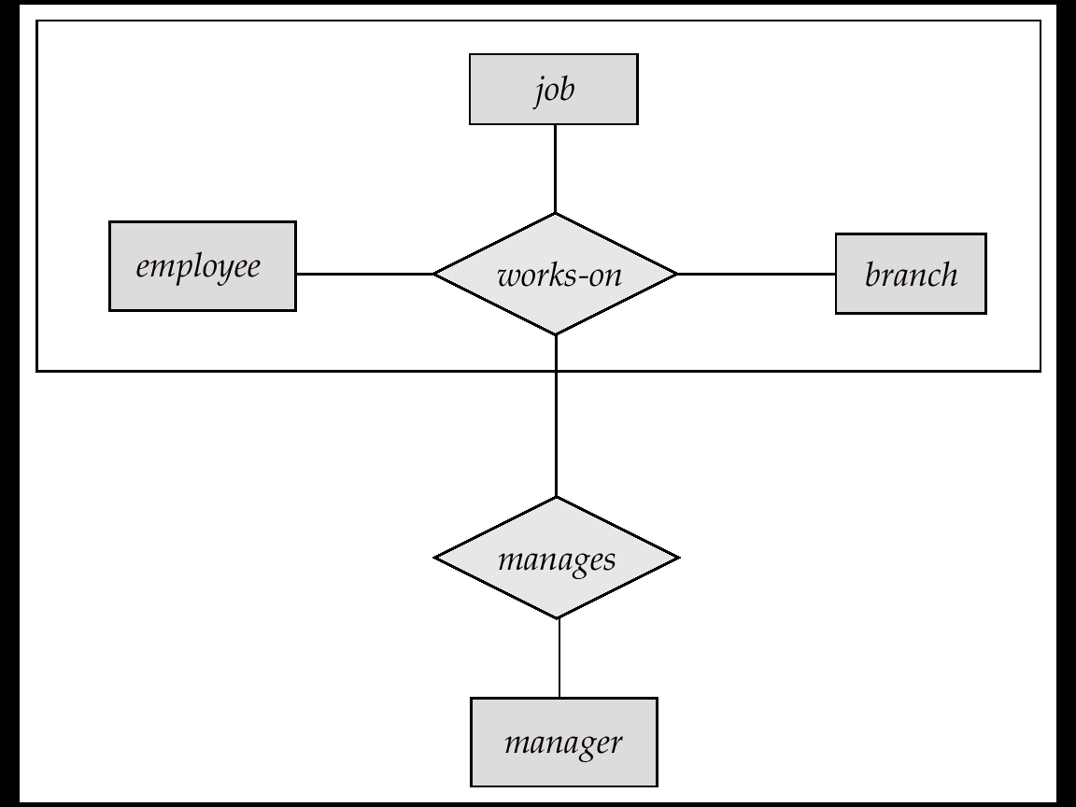
Schemas Corresponding to Aggregation
Schema works_on is redundant provided we are willing to store null values for attribute manager_name in relation on schema manages
Chapter5 Entity-Relationship Model

Slide 105

Conclusions
Chapter5 Entity-Relationship Model

Slide 106

Questions?
Chapter5 Entity-Relationship Model

Slide 107
End of Chapter 6

